Slide 1
AI FOR GOOD · HACKATHON 7 RESIT
Hogweed
Guard NL
A three-class Roboflow screening MVP for Dutch nature volunteers
K1 Roboflow AI model
K2 SDG 15, target 15.8
K3 One bounded workflow
Max Lopez · individual resit · github.com/Maxlopez02/ai4g-portfolio-MaxLopez

Slide 2
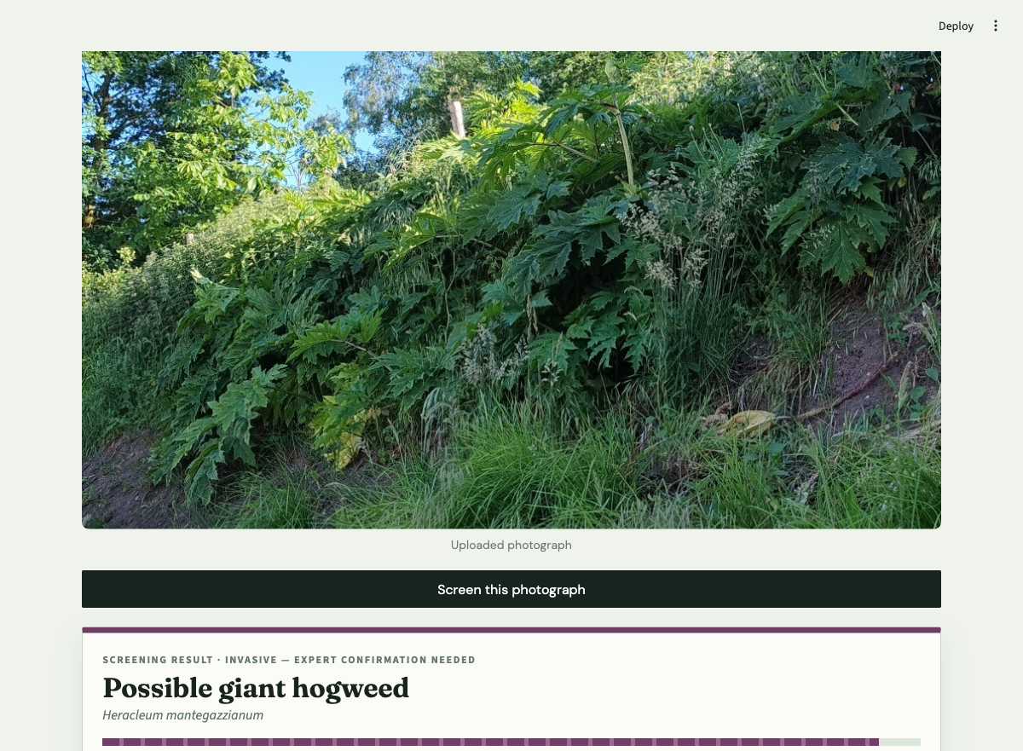
K1 · The trained AI model is the core function
MODEL
Roboflow DINOv3 Small
The Streamlit app sends the uploaded photograph to a trained three-class Roboflow Workflow. The returned confidence scores determine the screening result.
client.run_workflow(
images={"image": image}
)
Without this model call, the app cannot produce a plant screening result. There is no rule-based fallback.
2/7

Slide 3
K2 · Direct link to SDG target 15.8
Target 15.8
Reduce the impact of invasive alien species on land and water ecosystems and support control of priority species.
01
02
03
Local problem
User decision
Intended benefit
The Dutch NVWA reports that giant hogweed can form dense stands that displace other plants. People may confuse it with native common hogweed.
A nature volunteer screens one photograph, keeps distance and records the location. Weak model scores are withheld.
Earlier expert reporting of a suspected invasive plant, with less risk of acting against a native look-alike.
The MVP supports screening and referral. It does not claim that image classification alone controls invasive species.
Sources: United Nations, Goal 15 target 15.8 · Dutch NVWA, Factsheet reuzenberenklauw (2025)
3/7

Slide 4
K3 · A bounded screening MVP
Included
Explicitly excluded
USER
Dutch nature volunteer
AUDIENCE
General plant-identification users
INPUT
One plant photograph
FEATURES
Live camera, map, GPS or batch upload
MODEL
Three named plant classes
COVERAGE
Every Dutch plant species
OUTPUT
Class score or uncertain
CLAIM
Confirmed botanical identification
NEXT STEP
Expert confirmation
ADVICE
Removal, medical or legal decisions
Success means one complete photo-to-model-to-cautious-result flow with visible limitations.
4/7

Slide 5
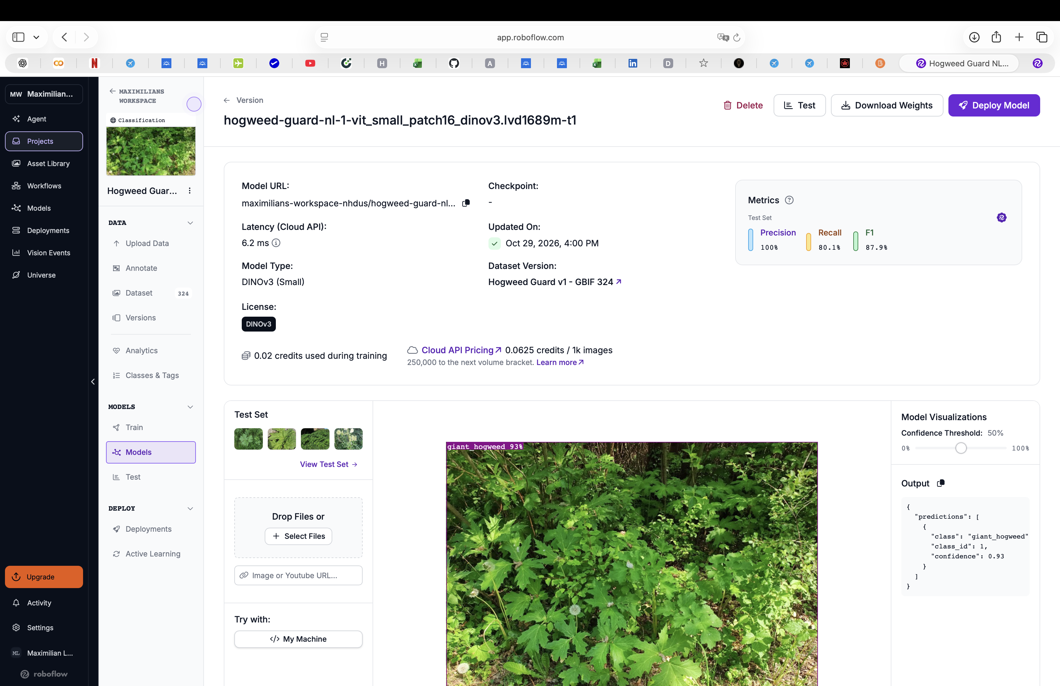
Held-out testing defines the safety limit
30 / 36 correct
83.3% accuracy on images excluded from training
Giant hogweed 10/12
Common hogweed 8/12
Cow parsley 12/12
SAFETY-RELEVANT ERRORS
One giant-hogweed image was predicted as common hogweed. One common-hogweed image was predicted as giant hogweed.
Safeguard: withhold scores below 65% and require expert confirmation before action.
5/7

Slide 6
The repository makes the resit reproducible
PUBLIC REPOSITORY
github.com/Maxlopez02/ai4g-portfolio-MaxLopez/
tree/main/Resit/Week%207/hackathon
Run
Verify
1 pip install -r requirements.txt
2 Copy .env.example to .env
3 streamlit run app.py
4 Upload one test photograph
app.py Roboflow call and interface
model_logic.py response parsing
tests/ offline threshold tests
evidence/ model and app screenshots
.env.example safe configuration template
Private credentials stay outside Git. The resit includes everything else needed to inspect the implementation.
6/7

Slide 7
Contribution record and knockout closeout
Max Lopez
K1
Roboflow model named, called in code and evidenced
Individual resit author
Max completed the repository, model integration, interface, scope definition, SDG mapping, safety logic, tests, documentation and presentation.
K2
SDG 15 target 15.8 mapped to the user workflow
Sofiia clarification
K3
One user, one photo, three classes, one cautious result
This individual resit claims no contribution from Sofiia. No code, data or written evidence from Sofiia appears in the resit folder.
Assessment basis: Max Lopez’s individual Hackathon 7 resit
7/7

